Slide 1
M110: Python Programming Self-Study#3 Collection Data Types Dictionaries & Sets
Prepared by Dr. Ahmad Mikati

Slide 2
Contents
Dictionaries:
Creating dictionaries
Inserting, retrieving, adding, and deleting key-value pairs
Dictionary methods
Sets:
Creating sets
Adding elements to and removing elements from sets
Finding set union, intersection, difference and symmetric difference
Finding subsets and supersets

Slide 3
Introduction
Python programming language has four collection data types- list, tuple, sets and dictionary. They have different characteristics based on the declaration and the usage.
In this lecture, we will look at two of the fundamental additional types: Dictionaries and Sets.
We will explore some of the operations that you may perform on these types, including ways to access and manipulate their contents.

Slide 4
Dictionaries
When you hear the word “dictionary,” you probably think about a large book containing words and their definitions. If you want to know the meaning of a particular word, you locate it in the dictionary to find its definition.
In Python, a dictionary is an object that stores a collection of data. Each element that is stored in a dictionary has two parts: a key and a value. Key-value pairs are often referred to as mappings because each key is mapped to a value.
In fact, dictionary elements are commonly referred to as key-value pairs. When you want to retrieve a specific value from a dictionary, you use the key that is associated with that value.
An example would be a program that lets us enter a person’s name and gives us that person’s phone number. The program could use a dictionary in which each element contains a person’s name as the key, and that person’s phone number as the value. If we know a person’s name, then we can retrieve that person’s phone number.

Slide 5
Creating a Dictionary
You can create a dictionary by enclosing the elements inside a set of curly braces ( {} ).
An element consists of a key, followed by a colon (:), followed by a value. The elements are separated by commas.
phonebook = {'Jamil':'963−11112222', 'Fadia':'692−43219876', 'Mazen':'961−3665169'}
In the above example, the keys and the values are strings. The values in a dictionary can be objects of any type, but the keys must be immutable objects.
For example, keys can be strings, integers, floating-point values, or tuples.
Keys cannot be lists or any other type of mutable objects.
Dictionaries themselves are mutable, so entries can be added, removed, and changed at any time.
Note, though, that because entries are accessed by their key, we can't have two entries with the same key.

Slide 6

Retrieving a Value from a Dictionary
The elements in a dictionary are not stored in any particular order. For example, look at the following interactive session in which a dictionary is created, and its elements are displayed:
Notice the order in which the elements are displayed is different than the order in which they were created.
This illustrates how dictionaries are not sequences, like lists, tuples, and strings.
As a result, you cannot use a numeric index to retrieve a value by its position from a dictionary.
Instead, you use a key to retrieve a value.

Slide 7
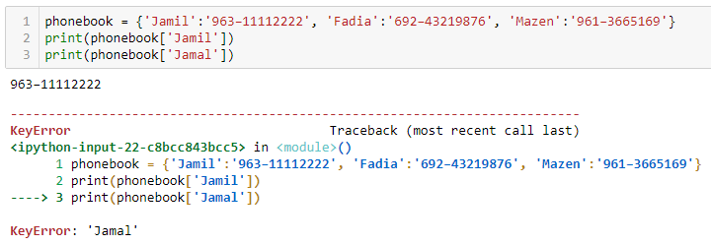
Retrieving a Value from a Dictionary
To retrieve a value from a dictionary, you simply write an expression in the following general format:
dictionary_name[key]
In the general format, dictionary_name is the variable that references the dictionary, and key is a key.
If the key exists in the dictionary, the expression returns the value that is associated with the key. If the key does not exist, a KeyError exception is raised.

Slide 8
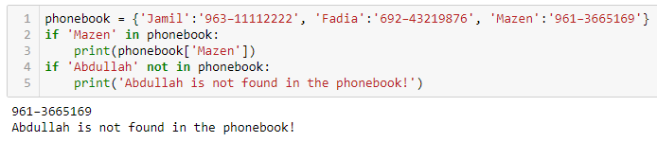
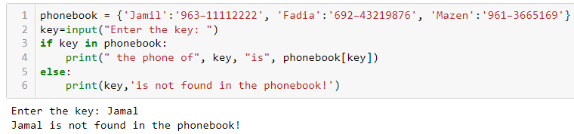
Using the in and not in Operators to Test for a Value in a Dictionary
As previously demonstrated, a KeyError exception is raised if you try to retrieve a value from a dictionary using a nonexistent key.
To prevent such an exception, you can use the in operator to determine whether a key exists before you try to use it to retrieve a value.
You can also use the not in operator to determine whether a key does not exist.
N.B: Keep in mind that string comparisons with the in and not in operators are case sensitive!

Slide 9
Adding Elements to a Dictionary
You can add a key-value pair to a dictionary using a new index key and assigning a value to it:
# adding to/updating a dictionary
phonebook = {'Jamil':'963−11112222', 'Fadia':'692−43219876', 'Mazen':'961−3665169'}
phonebook['Jamal']='961-76411262'
phonebook['Fadia']='962-43219875’
print(phonebook)
{'Jamil': '963−11112222', 'Fadia': '962-43219875', 'Mazen': '961−3665169', 'Jamal': '961-76411262'}

Slide 10
Deleting Elements from a Dictionary
You can delete an existing key-value pair from a dictionary with the del statement. Below is the general format:
del dictionary_name[key]
After the statement executes, the key and its associated value will be deleted
from the dictionary. If the key does not exist, a KeyError exception is raised.
phonebook = {'Jamil':'963−11112222', 'Fadia':'692−43219876', 'Mazen':'961−3665169'}
del phonebook['Fadia’]
print(phonebook)
{'Jamil': '963−11112222', 'Mazen': '961−3665169'}

Slide 11
More about Dictionaries
Finding the Number of Elements in a Dictionary
You can use the built-in len function to get the number of elements in a dictionary.
phonebook = {'Jamil':'963−11112222', 'Fadia':'692−43219876', 'Mazen':'961−3665169'}
print(len(phonebook)) 3
Creating an Empty Dictionary
You can use an empty set of curly braces to create an empty dictionary {}.
Mixing Data Types in a Dictionary
The keys in a dictionary must be immutable objects, but their associated values can be any type of object. The keys can be of different types, too, as long as they
are immutable.
Key types: string, integer, tuple
mixed_types = {‘dani':1, 2022:”Elections”, (1, 2, 3):[3, 6, 9]}
Value types: integer, string, list

Slide 12
Useful Dictionary Methods/Functions
Method | Description
clear | Clears the contents of a dictionary.
get | Gets the value associated with a specified key. If the key is not found, the method does not raise an exception. Instead, it returns a default value.
items | Returns all the keys in a dictionary and their associated values as a sequence of tuples.
keys | Returns all the keys in a dictionary as a sequence of tuples.
pop | Returns the value associated with a specified key and removes that key-value pair from the dictionary. If the key is not found, the method returns a default value.
popitem | Returns a randomly selected key-value pair as a tuple from the dictionary and removes that key-value pair from the dictionary.
values | Returns all the values in the dictionary as a sequence of tuples.
Function | Description
in | returns True iff the dictionary contains an entry with the tested key
len | returns the number of elements in a dictionary
zip | allows you to combine two or more iterables, such as lists, tuples, or dictionaries, into a single iterable.

Slide 13
Examples
# Create two lists
names = ["Alice", "Bob", "Charlie"]
ages = [25, 30, 28]
# Create a dictionary using zip()
people = dict(zip(names, ages))
print("Original dictionary:", people)
Output: {'Alice': 25, 'Bob': 30, 'Charlie': 28}
# Clear the dictionary
people.clear()
print("Dictionary after clearing:", people)
Output: {}

Slide 14
Examples
people={'David': 35, 'Emily': 22}
# Get all values as a list
values_list = list(people.values())
print("List of values:", values_list)
Output: [35, 22]
# Get the value for a specific key
age_of_bob = people.get("Bob")
print("Age of Bob:", age_of_bob)
Output: None (since "Bob" is not in the dictionary)
# Get the value for a specific key, with a default value if not found
age_of_david = people.get("David", "Not found")
print("Age of David:", age_of_david)
Output: 35

Slide 15
Sets
A set is an object that stores a collection of data in the same way as mathematical sets.
There are some aspects that you should know about sets:
All the elements in a set must be unique. No two elements can have the same value.
Sets are unordered, which means that the elements in a set are not stored in any order.
Stored elements in a set can be of different data types.

Slide 16
Sets
Creating a Set
To create a set, you need to call the built-in set function.
For example, my_set = set() to create an empty set;
The argument that you pass must be an object that contains iterable elements, such as a list, a tuple, or a string.
The individual elements of the object that you pass as an argument become elements of the set.
set1=set(['x', 'y', 'z'])
print(set1)
{'y', 'x', 'z'}
a set containing the elements ‘x', ‘y', and ‘z'.
set2=set('ahmad')
print(set2)
{'a', 'h', 'm', 'd'}
Sets cannot contain duplicate elements.
What if you want to create a set in which each element is a string containing more than one character?

Slide 17
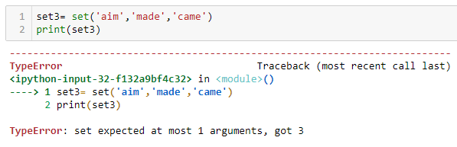

Sets
Creating a Set
If you want to create a set in which each element is a string containing more than one character, you should pass a list containing the strings.

Slide 18
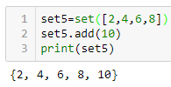
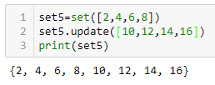
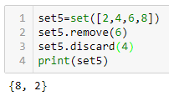
Sets
Adding, updating, and Removing Elements
Sets are mutable objects, so you can add items to them, update the sets, and remove items from them.
You use the add method to add an element to a set.
You can add a group of elements to a set all at one time with the update method.
You can remove an item from a set with either the remove method or the discard method.

Slide 19
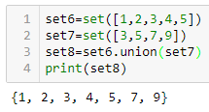
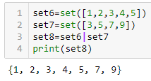
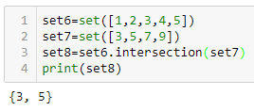
Sets
Finding the Union and Intersection of Sets
The union of two sets is a set that contains all the elements of both sets, while the intersection of two sets is a set that contains only the elements that are found in both sets.
In Python, you can call the union method (or |) to get the union of two sets.
Moreover, you can call the intersection method to get the intersection of two sets.
or

Slide 20
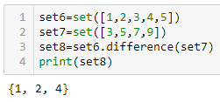
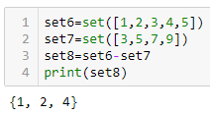
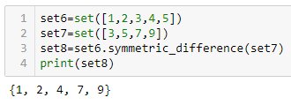
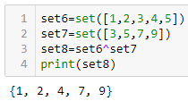
Sets
Finding the Difference and Symmetric Difference of Sets
The difference of set1 and set2 is the elements that appear in set1 but do not appear in set2, while the symmetric difference of two sets is a set that contains the elements that are not shared by the sets.
You can call the difference method (or -)to get the difference of two sets.
You can call the symmetric_difference method (or ^)to get the symmetric difference of two sets.
or
or

Slide 21
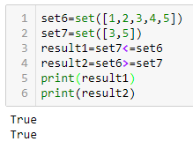
Sets
Finding Subsets and Supersets
In Python, you can call the issubset method (or <=) to determine whether one set is a subset of another. The method returns True if set2 is a subset of set1. Otherwise, it returns False.
Also, you can call the issuperset method (or >=) to determine whether one set is a superset of another. The method returns True if set1 is a superset
of set2.

Slide 22
Summary
This lecture covered:
Dictionaries, including:
Creating dictionaries
Inserting, retrieving, adding, and deleting key-value pairs
Dictionary methods
Sets, including:
Creating sets
Adding elements to and removing elements from sets
Finding set union, intersection, difference and symmetric difference
Finding subsets and supersets

